Slide 1
Corona Virus Data Analysis
Presentation
By
Amal Thomas

Slide 2

SQL
Easy to learn and use across different database management systems such as MySQL, PostgreSQL, and Oracle.
SQL Stands for Structured Query language
Used for tasks such as querying data from databases, inserting, updating, and deleting records.
A domain-specific language designed for managing and manipulating relational databases.

Slide 3
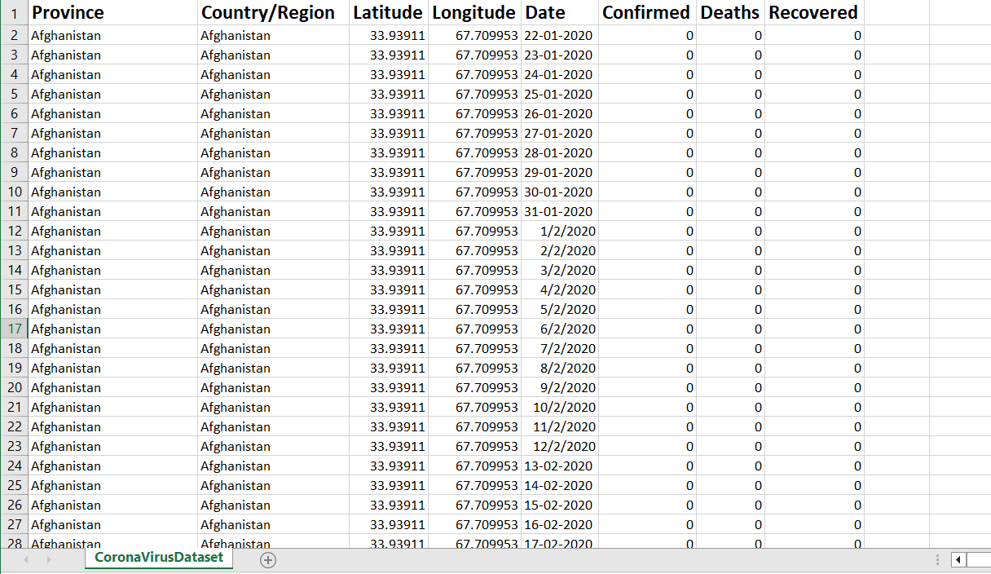
Data Set

Slide 4
Description of each column in dataset
Province: Geographic subdivision within a country/region.
Country/Region: Geographic entity where data is recorded.
Latitude: North-south position on Earth's surface.
Longitude: East-west position on Earth's surface.
Date: Recorded date of CORONA VIRUS data.
Confirmed: Number of diagnosed CORONA VIRUS cases.
Deaths: Number of CORONA VIRUS related deaths.
Recovered: Number of recovered CORONA VIRUS cases.

Slide 5
Questions Overview
Q1. Write a code to check NULL values
Q2. If NULL values are present, update them with zeros for all columns.
Q3. check total number of rows
Q4. Check what is start_date and end_date
Q5. Number of month present in dataset
Q6. Find monthly average for confirmed, deaths, recovered
Q7. Find most frequent value for confirmed, deaths, recovered each month
Q8. Find minimum values for confirmed, deaths, recovered per year
Q9. Find maximum values of confirmed, deaths, recovered per year
Q10. The total number of case of confirmed, deaths, recovered each month
Q11. Check how corona virus spread out with respect to confirmed case -- (Eg.: total confirmed cases, their average, variance & STDEV)
Q12. Check how corona virus spread out with respect to death case per month -- (Eg.: total confirmed cases, their average, variance & STDEV )
Q13. Check how corona virus spread out with respect to recovered case -- (Eg.: total confirmed cases, their average, variance & STDEV)
Q14. Find Country having highest number of the Confirmed case -- Q15. Find Country having lowest number of the death case
Q16. Find top 5 countries having highest recovered case

Slide 6
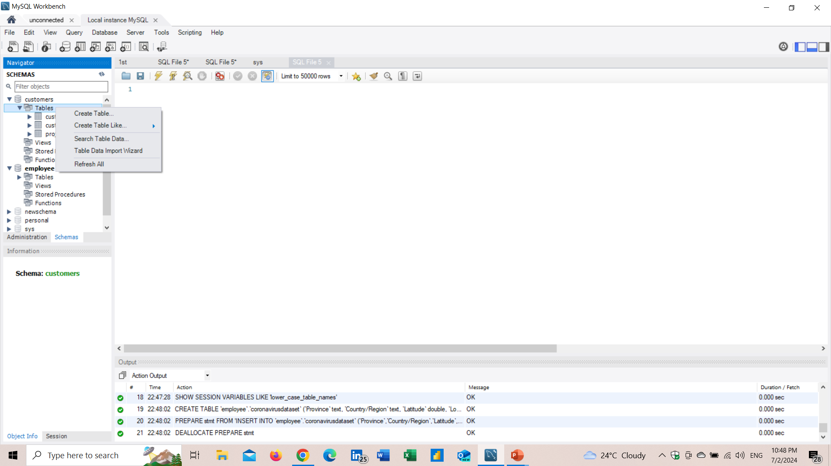
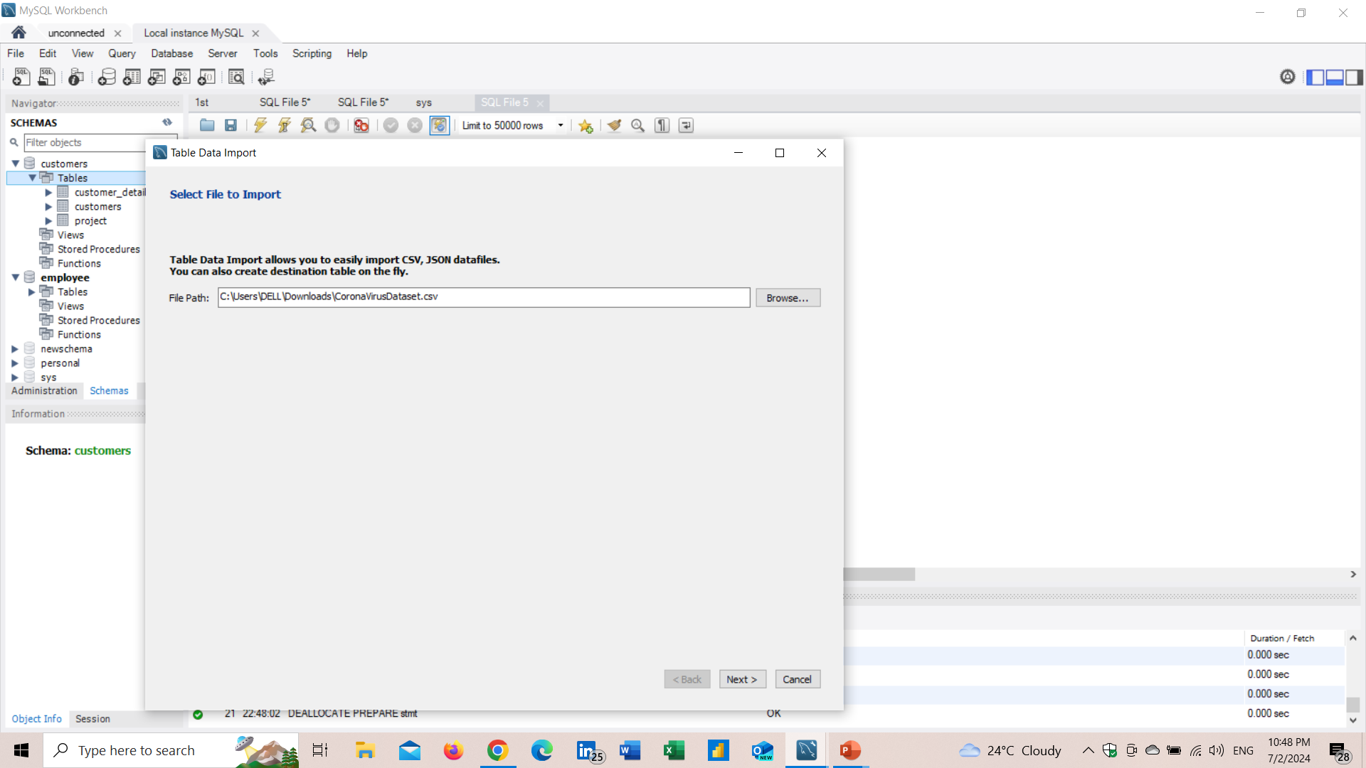
Loading Data
Create a Data Base(eg;Customers)
Create a Table under Database(eg;Project)
Here I have named the corona data set as Project
Then right click on table then we can import data to our target table

Slide 7
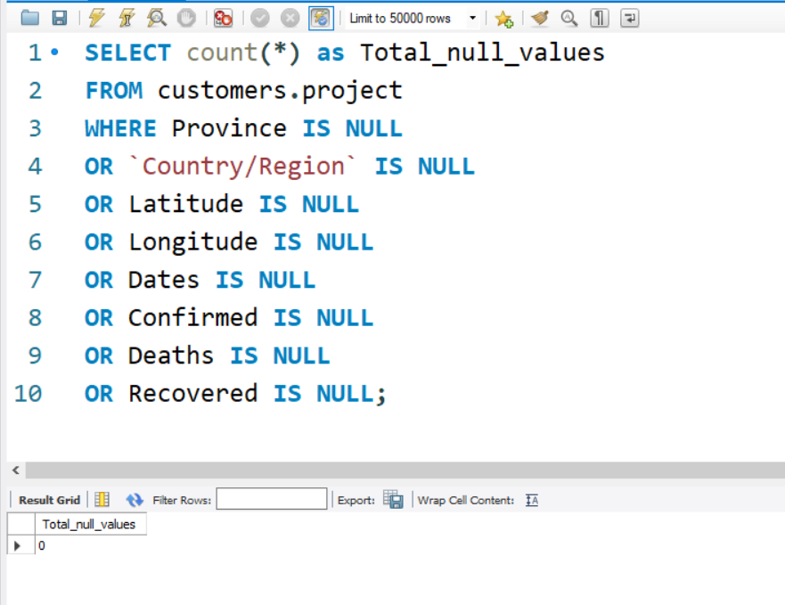
Write a code to check NULL values

Slide 8
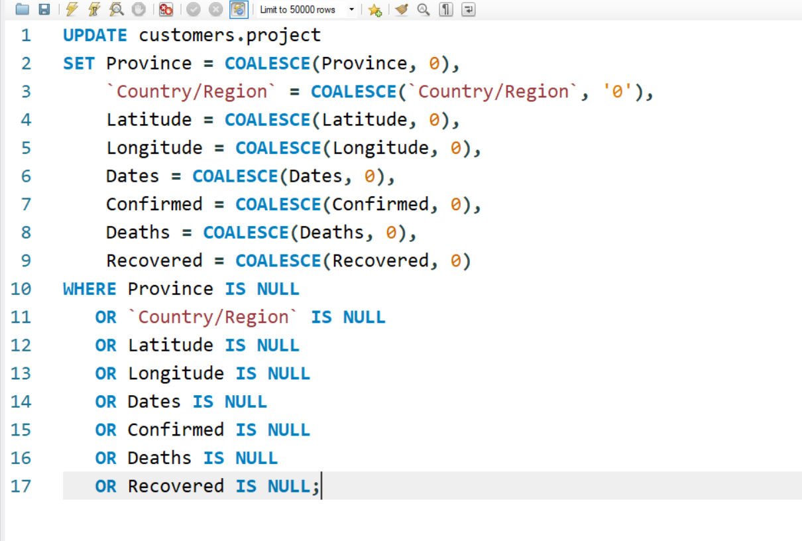
If NULL values are present, update them with zeros for all columns.
No NULL Values are present

Slide 9
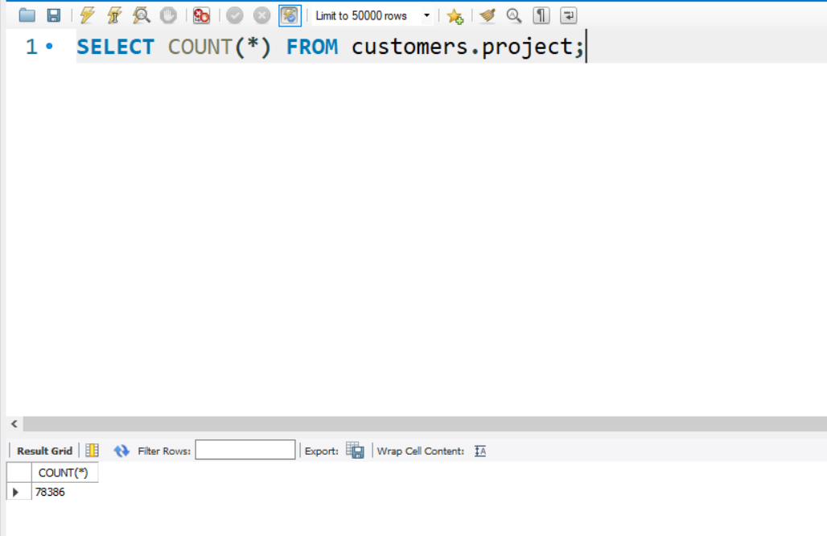
check total number of rows

Slide 10
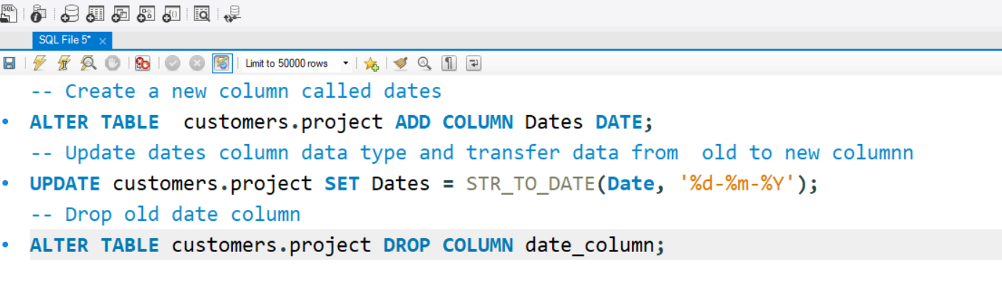

Slide 11
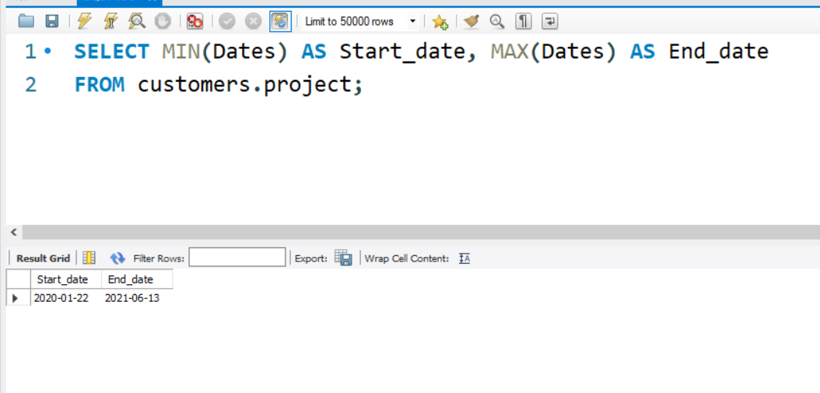
Check what is start date and end date

Slide 12
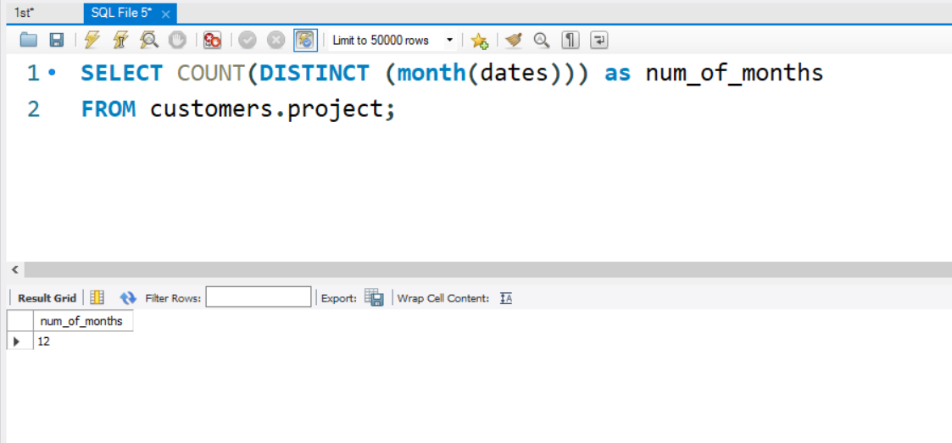
Number of month present in dataset

Slide 13
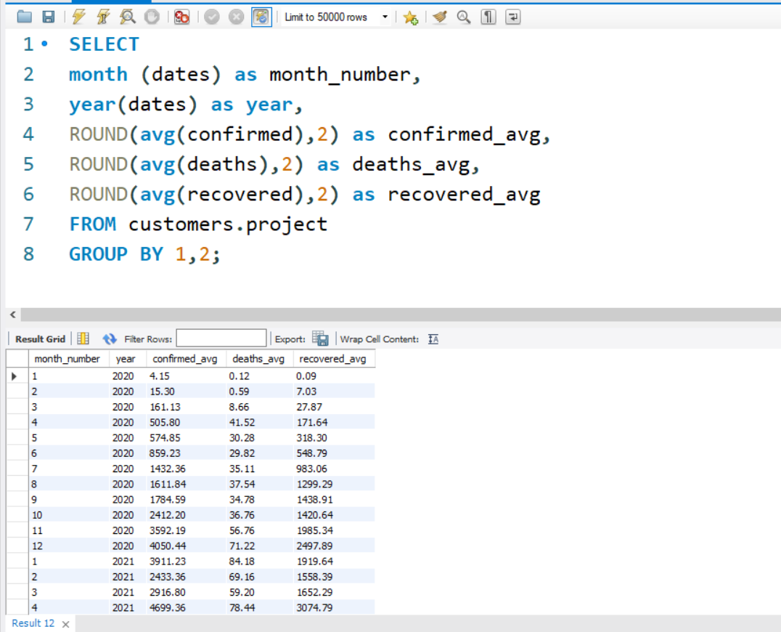
Find monthly average for confirmed, deaths, recovered

Slide 14
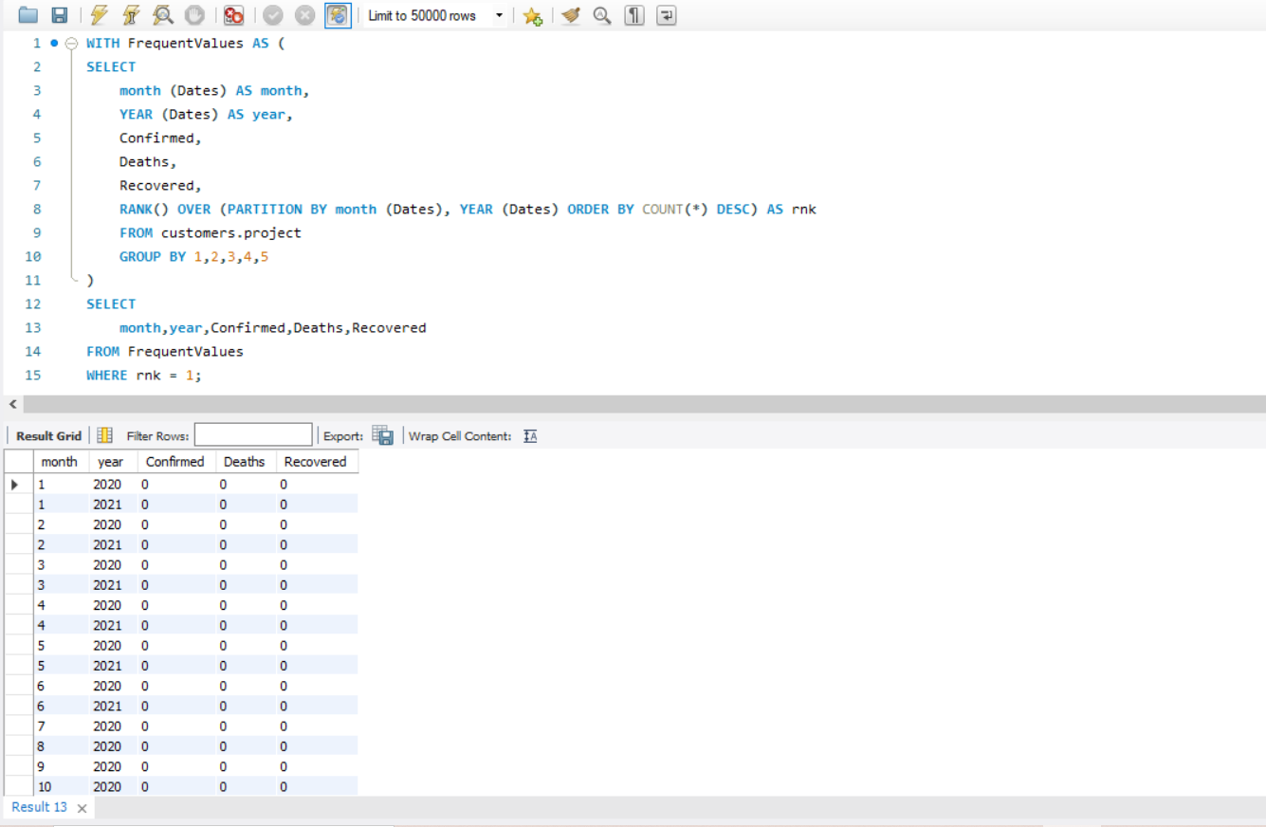
Find most frequent value for confirmed, deaths, recovered each month

Slide 15
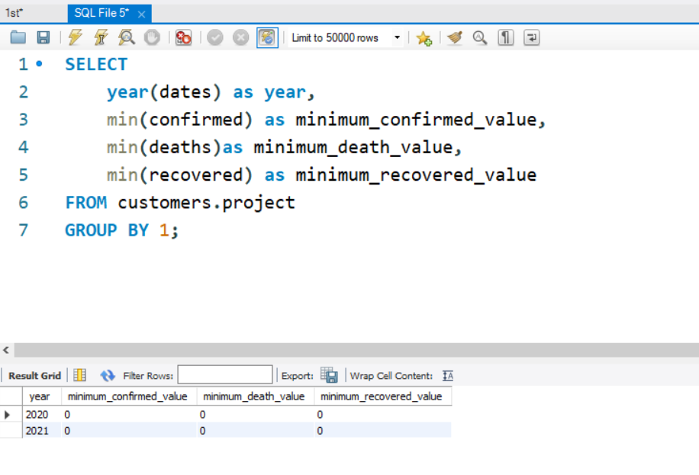
Find minimum values for confirmed, deaths, recovered per year

Slide 16
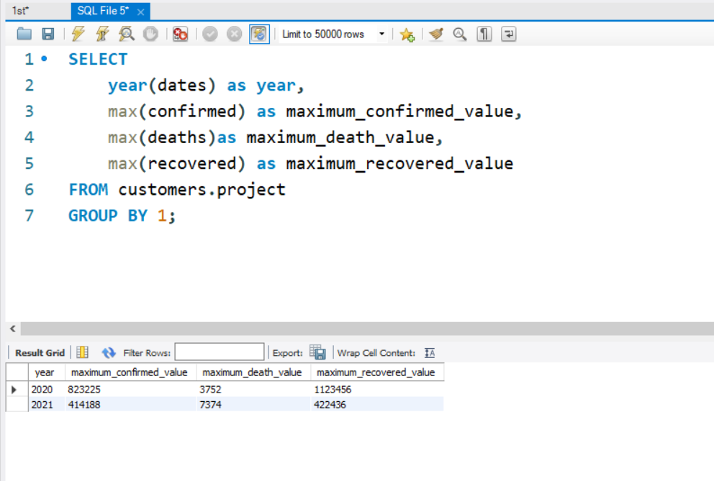
Find maximum values of confirmed, deaths, recovered per year

Slide 17
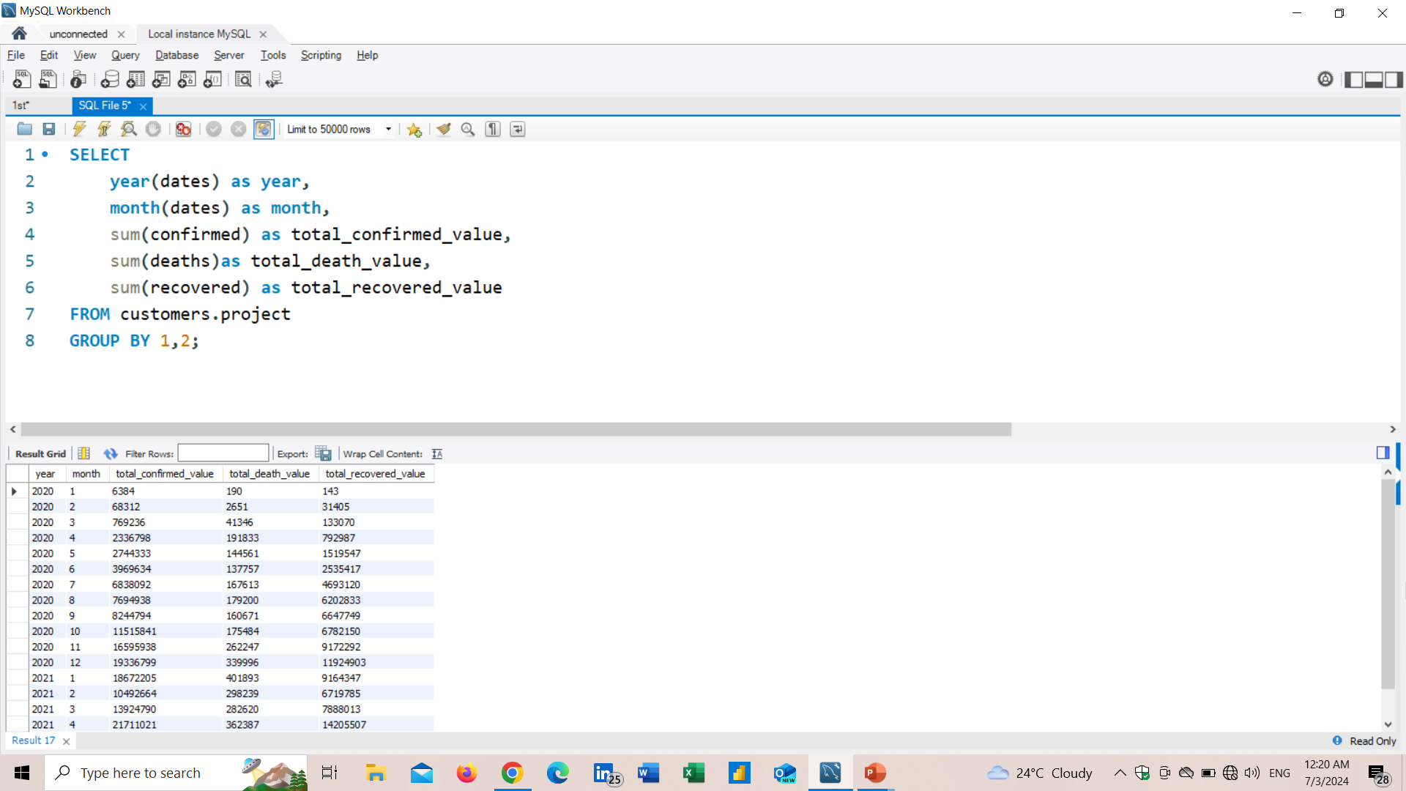
The total number of case of confirmed, deaths, recovered each month

Slide 18
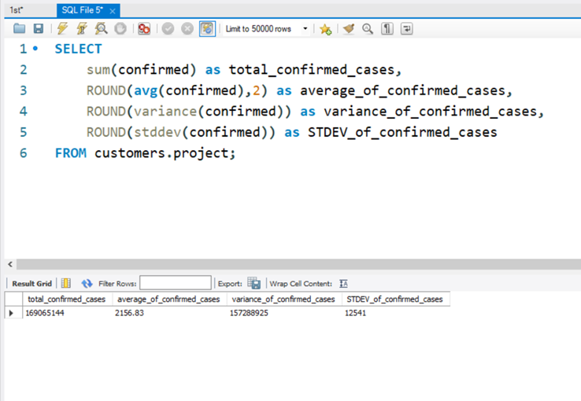
Check how corona virus spread out with respect to confirmed case

Slide 19
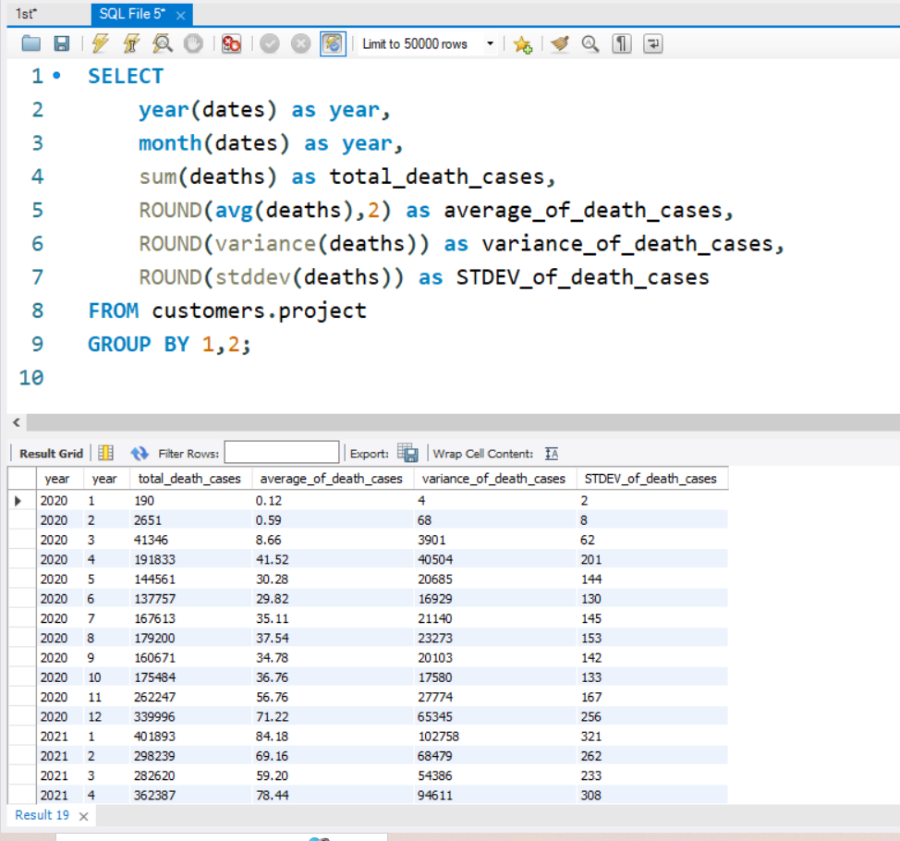
Check how corona virus spread out with respect to death case per month

Slide 20
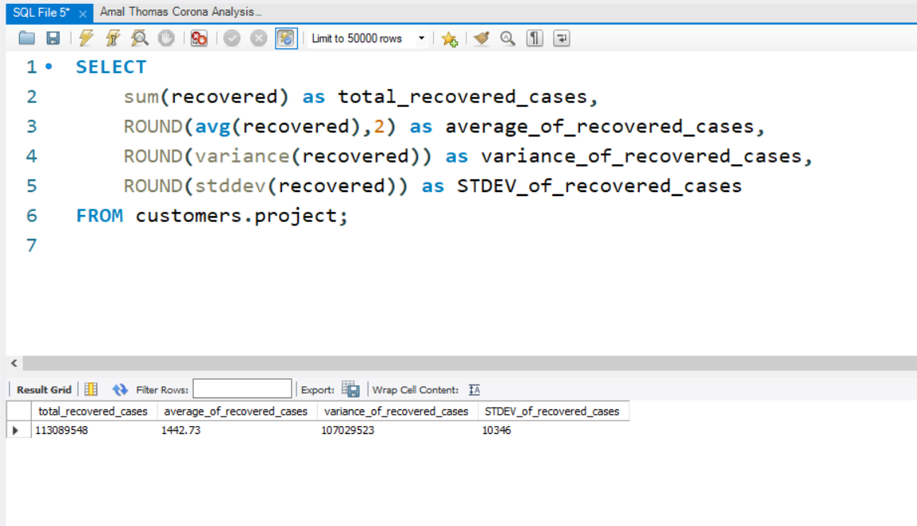
Check how corona virus spread out with respect to recovered case

Slide 21
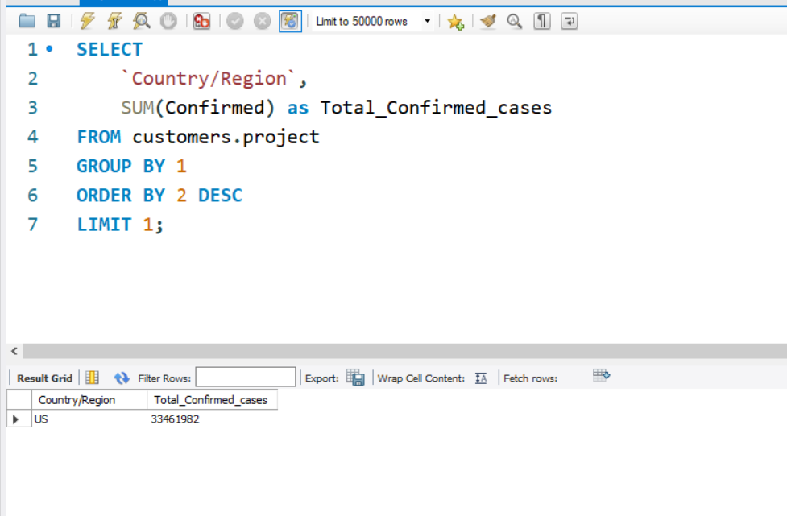
Find Country having highest number of the Confirmed case

Slide 22
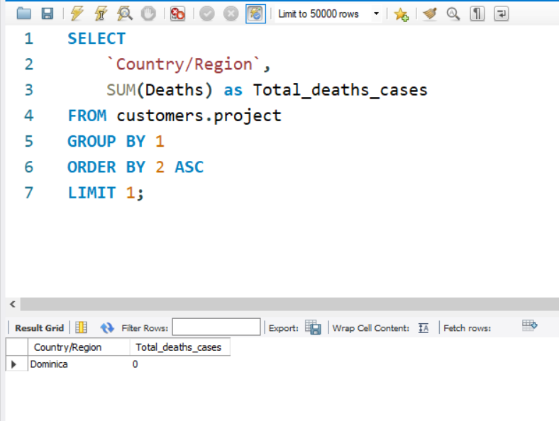
Find Country having lowest number of the death case

Slide 23
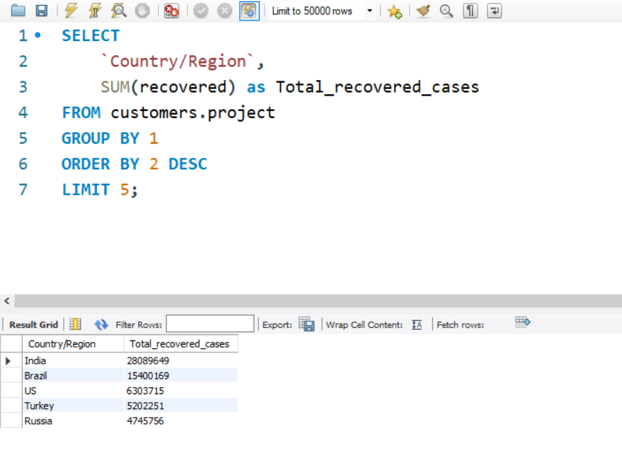
Find top 5 countries having highest recovered case

Slide 24
Insights
Null Values Present
Total Number of rows
Analysis data Between
Number of unique months is
Minimum value of confirmed, death and recovered
maximum values of recovered case is higher than other 2
Country with highest confirmed cases
Country with lowest death cases
India, US, Brazil, Turkey and Russia are highest recovered cases countries
0
78386
2020-01-22 and 2021-06-13
12 and total 18 months between 2020 and 2021
0
422436
US
Dominica

Slide 25
Thank You!

